Slide 1

Zomato Sales Analysis
Abhishek Kunwar

Slide 2

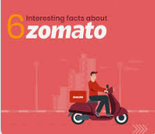
Around 2008, people in Delhi were fed up with manual searching of delivery menus of different restaurants around them. Deepinder Goyal and Pankaj Chaddah, the founders of Zomato made the most of this opportunity by launching a food directory service. They called it FoodieBay. In just 9 mthm, it became the largest and a popular restaurant directory in all of Delhi.
It’s revenue grew from Rs. 1,300 cr. in FY 2019 to Rs. 2,800 cr. in FY 2020. It is already profitable at EBITDA level in the food delivery business. During Q2 2019, it was burning about Rs. 290 cr. every month

Slide 3

PROBLEM STATEMENT
±To identify optimal countries and cities for opening new restaurants by analysing existing restaurant performance, market demand, and economic factors, ensuring profitable and strategic expansion.

Slide 4

Data Cleaning and Processing
Total 15 countries, restaurant name, locality, cuisines it offer.
Dataset contains information about restaurant name, id, locality, longitude, latitude, date of opening,currency used, average cost of two, has online delivery service available or not
Data Cleaning and processes
Cuisines contains some null values which is handled by ifblank
Normalized currency with average cost of two people
Standarized date format in readable format
Processed various currencies and converted them into INR and USD for comparison.
Used LOOKUP functions to fetch the appropriate country codes.

Slide 5
Methodology
Data Cleaning - Using ifna() , trim, clear function to handle missing values
Data Preprocessing - Enhanced dataset with additional column name of country extracted using XLOOKUP to cross reference external data sets
Data Enrichment - Applied CONCATENATE, MID, FIND function to attain customized price value using currency and price
Descriptive Analysis - Employed PIVOT table to summarize key metrics and identify count of restaurants in each country, cities and price of each. It also helps in understanding which restaurant is highly rated and what factors affect it.
Visualization - creating dynamic charts and dashboards for data visualization.

Slide 6
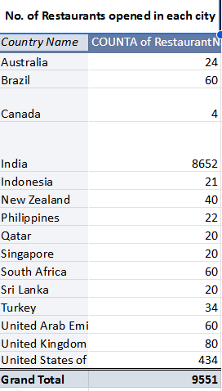
No. of Restaurants opened in each city
8,652 restaurants (90%+ of total) are in India, indicating a highly competitive food industry
434 restaurants are located in the USA, showing significant market presence.
Qatar & Sri Lanka Have Low Competition.Only 20 restaurants each → Indicating potential for new business expansion.These countries could be ideal for launching new restaurants with lower competition
Australia, Canada, Singapore, & New Zealand Have Minimal Presence .Fewer than 50 restaurants in each country → Scope for growth & expansion in these markets

Slide 7
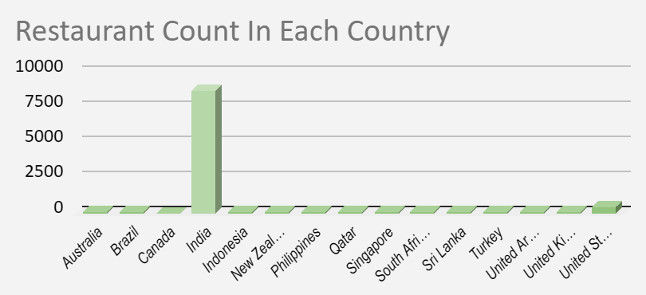

Slide 8
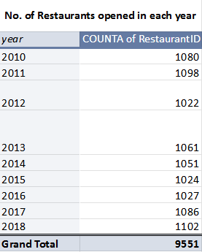
Restaurants opened each year
The number of restaurants opened each year remains relatively stable, averaging around 1,050 per year.Indicates a consistent demand for new restaurant ventures
2018 saw the highest number of restaurant openings, suggesting strong market confidence
2012 (1,022) and 2015 (1,024) had lower openings
A steady upward trend in recent years (2016-2018) indicates increasing opportunities for new restaurants.

Slide 9
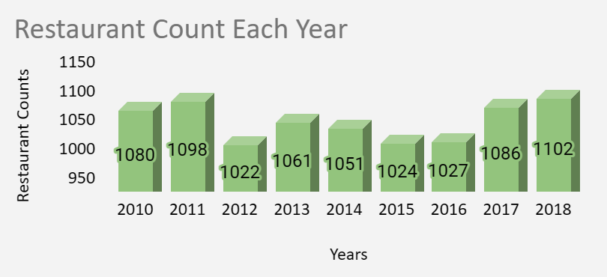

Slide 10
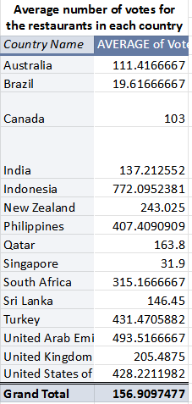
Indonesia Has the Highest Average Votes (772) which suggest higher engagement, indicating a strong food culture and active customer reviews.
United Arab Emirates (493) & Turkey (431) Also Show High Engagement. They have above-average customer voting patterns, suggesting strong customer interaction.
India Has a Moderate Voting Average (137).Despite India having the most restaurants (8,652), the average votes per restaurant remain moderate.This suggests either a dispersed market or less customer engagement in voting.
Countries with Low Engagement: Brazil (19), Singapore (31) Brazil & Singapore have the lowest average votes

Slide 11
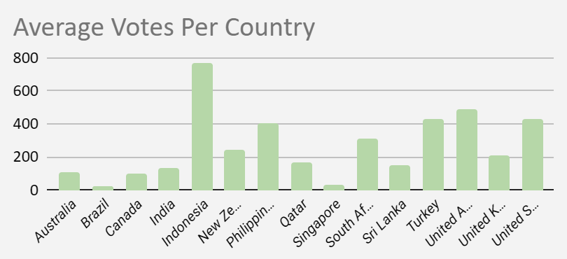

Slide 12
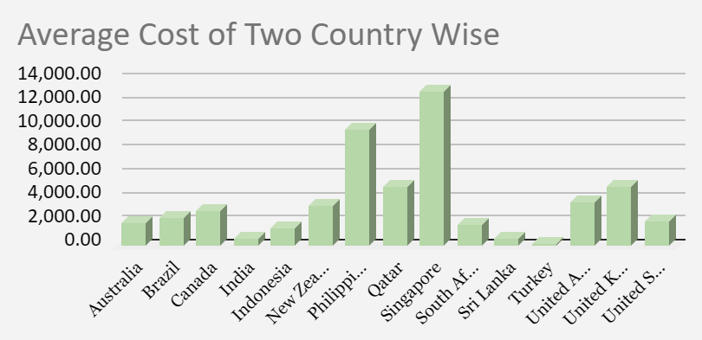
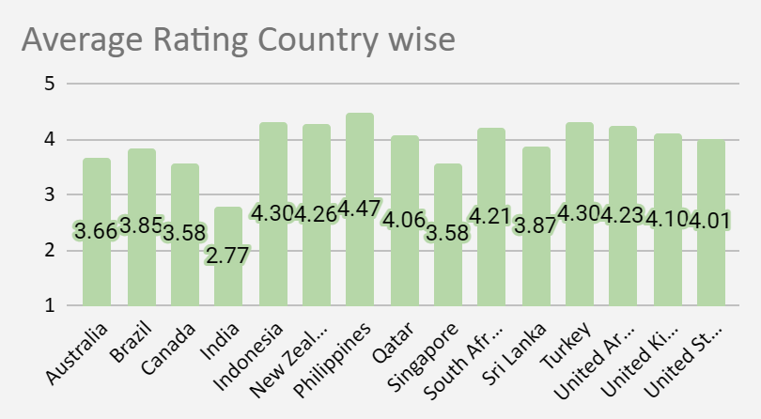
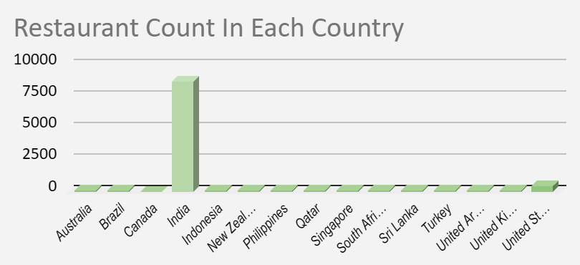
Countries where the team can open newer restaurants with lesser competition
Country Name | COUNTA of RestaurantID | AVERAGE of Price in Rupees | AVERAGE of Rating
Brazil | 60 | ₹2,356.67 | 3.846666667
Indonesia | 21 | ₹1,518.43 | 4.295238095
South Africa | 60 | ₹1,855.22 | 4.21
Sri Lanka | 20 | ₹617.50 | 3.87
Turkey | 34 | ₹261.35 | 4.3
Grand Total | 195 | ₹1,568.39 | 4.088205128
The most suitable countries for opening new restaurants are those where:
The average ratings are higher than 3.8.
The total number of restaurants is less than 60.
The average cost of two is less than 700 rupees.

Slide 13
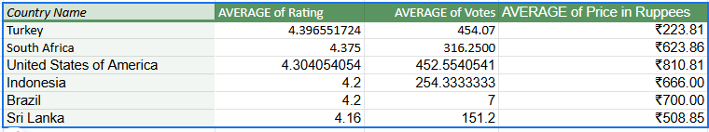

Current Quality regarding ratings for Restaurants

Slide 14
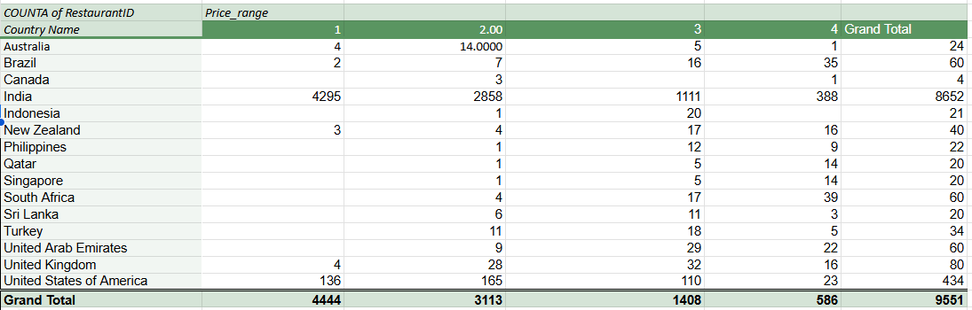
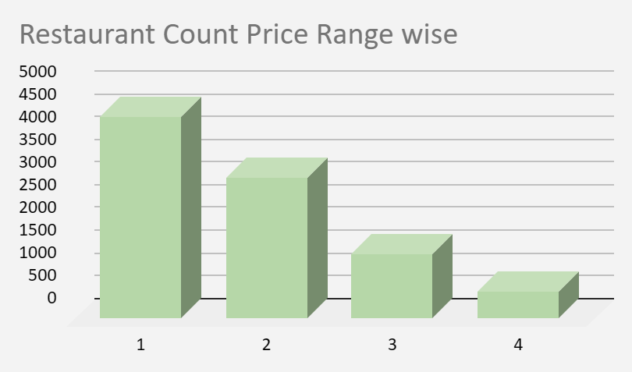
Restaurant Distribution according to price range
Insights-
India Dominates the Low-Price Market
Premium Dining is More Common in Brazil, Qatar, Singapore, and South Africa have a higher proportion of high-end restaurants (Price Range 4).
Canada, Indonesia, Philippines, Qatar, and Singapore have very few or no restaurants in Price Range 1
The United States and the United Kingdom show a relatively balanced spread across all price ranges, indicating diverse customer preferences.

Slide 15
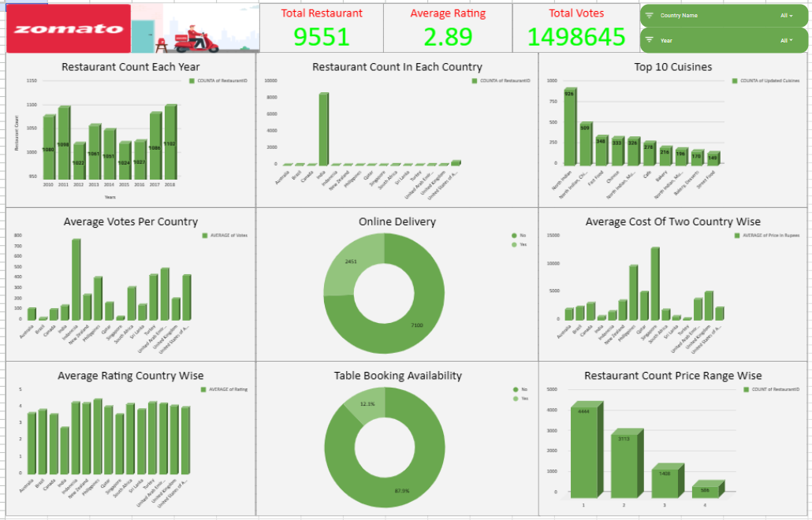
DASHBOARD

Slide 16
THANK YOU !!

